Slide 1
Entering The U.S. Market
Michael Romanies KOTRA 2008
Managing Partner Dallas, TX
VARConnection.com
Business Blogger: AllBusiness.com – Operational Excellence

Slide 2
Entering The U.S. Market
Prepare for a long term Investment
OEM
Branded Product
Establish a Presence
Logistics
Sales
Marketing
Public Relations

Slide 3
Entering The U.S. Market
Logistics
F.O.B Destination
Product Availability
Reverse Logistics
Distribution
Sales
Direct Sales
Manufacturers Representatives
Brokers

Slide 4
Entering The U.S. Market
Marketing
Channel Support
Literature
Trade Shows
Retail/Distribution Events
Promotions
Advertising
Rebates
Displays

Slide 5
Entering The U.S. Market
Public Relations/Media
Reviews
News Releases
PR Tours
PR Events
ShowStoppers®
Ziff Davis

Slide 6
Market Channels
Retailers
Manufacturer
Distributors
Consumers
Web
Stores &
Catalogs

Slide 7
Logistics/Product Flow
Retailers
Manufacturer
Distributors
VAR Connection/Agent
Contract Logistics / Fulfillment
Consumers
Web
Stores &
Catalogs

Slide 8
Sales Channels
Mass Retailers
Distributors
Manufacturer
Manufacturers Rep. Firm
VAR Connection/Agent
Consumers
Web
Stores &
Catalogs

Slide 9
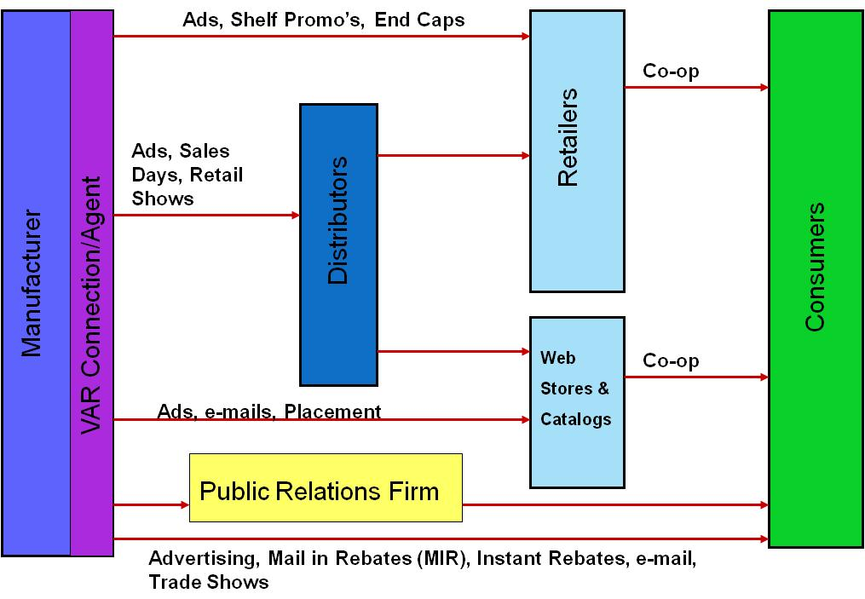
Marketing Programs

Slide 10
Entering The U.S. Market
Michael Romanies KOTRA 2008
Managing Director Dallas, TX
VARConnection.com
Business Blogger: AllBusiness.com – Operational Excellence

